Slide 2
VAS / RAC Theory
By Dr. Paul Nogier
Presented by Dr. Andy Roesti

Slide 3
Different Names
RAC: Réflex Auriculo Cardiac (1968 Nogier)
RAC: Réponse Autnome Circulatoire
ACR: Arterial Cardiac Reflex (Kenyon)
ART: Arterial Resonance Test (Wiebicke)
VAS: Vaso Autonomic Signal (De Sousa)
Chinese subjective Pulse Diagnosis
1945 Leriche
1968 Nogier

Slide 4
VAS: Vaso Autonomic Signal
No information of a standing wave
Not a reaction of the peripheral glomi carotici, regulating blood flow and temperature
Its a variability of the heartbeat
Its a variability of blood pressure in the time and not anymore in the length of measurement

Slide 5
Verification of VAS by means of a „sensory jacket“ of the MIR aerospace project
Plethysmographical blood pressure curves
Electrocardiogram
Seismocardiogram: dorsal-ventral distance
Ballistocardiogram: change of body length
Carotis pulse, radialis pulse, finger pulse
Breathing frequency

Slide 6
VAS proved 2008
Dr. Gerard Fiches from France could now prove the VAS by means of the Finometer Pro apparatus with an additionally computer (Expert Seminar Davos 2008)
Email: contact@ensaaf.ch.
Tel. +41 79 283 60 02

Slide 7
VAS is a sympathetic- and parasympathetic phenomenon
The control of the peripherical blood flow is regulated by different mechanisms:
The sympathetic nerve system with the Alpha- and Beta- receptors or the two hormones: Adrenalin and Noradrenalin
The parasympathetic nerve system and Acetylcholin
The vaso-motoric centres with Kallikrein and Bradykinin
Axon-reflexes, etc.

Slide 8
VAS Vaso-Autonomic-Signal
VAS is a neuro-vegetative processing and adaptation signal, due to the variation of myocardial actions
Peripheral stimuli are answered by the central nerve system
VAS is produced through the variability of the heartbeat
The heart is no pump, its an intermittent amplifier of the bloodstream

Slide 9
The Skin as sense Organ from Nickel-Schummer-Seiferle
Hair of touch
1
2
6
Hair
4
3
7
5
8
1. Free nerve endings, 2. Merkel touchcells, 3. Meissner bodies,
4. Krause endspikes, 5. Vater- Pacini lamellabodies,
6. Golgi-Mazzoni lamellabodies, 7. Ruffini bodies, 8. Sensibel nerves

Slide 10
Thermo-, mechano- and painreceptors in the Skin
Free nerve ending, coat- and sinus hairs
regulating temperature and the sensibel-sensoriell aspect (Capillary fibrisses of cats, Merkel sense cells of pigs)
Nerve ending bodies: Meissner- and Grandry-bodies: Small bulb-, disc-, or firecone like sensoriell cells
The sensible-sensorial Meissner-Bodies react on the speed of the pressure variability
Ending spikes: Krause-endingspikes in the epidermis

Slide 11
Vater-Pacini lamellabodies: regulating superficial and deep inside sesibility and blood pressure, mechanoreceptors in the mesenterium, regulating movements of stomach and intestines.
The sensible-sensorial Pacini-Bodies register the acceleration of the pressure variability
Both (Meissner- and Pacinibodies) may register qualitative and quantitative aspects of the arterial pulse
Golgi-Mazzoni and Ruffini lamella bodies: in the cutis and subcutis as very important receptors of the superficial sesibility of men
and animals

Slide 12
Provoking VAS Signals
Significans of pos. VAS: p<0.01
(The significance was examined by a non parametric Wilcoxon-Signed-Rank-Test)
Clapping hands: 60 %
Heinelamp: 40 %
3V-Hammer: 25 %
Toxic Vial: 20 %
Laser: 15 %
Placebo: 7 %
All types of stimulation show a slow-down of the heart rate at first,
which is a sign of vagal defend reaction and secondly a sympathetic artery counter action or balancing modality, which leads to a short increase of the pulse Amplitude in the proximal parts of the arterial blood vessels
VAS qualitative classification was
divided into three categories:
VAS noticable
VAS well noticeable (average)
VAS very well noticable

Slide 13
Detecting the VAS Signal
One Finger Method (Yes-No-answer)
  With the Thumb at the Acupuncture point LU 7
  With the Indexfinger at the Acupuncture points ST 9 or SI 19
Two Finger Method (Yes-No-answer)
  With the Index- and the Middle Finger at the Acupuncture point LU 7. Similar to the TCM three finger method
Three Finger Method (58 different Qualities)
  With the Index-, the Middle-, and the Ring- Finger at the radial artery (TCM)

Slide 14
Detecting VAS with the tip of the thumb (one finger method)
VAS becomes positive

Slide 15
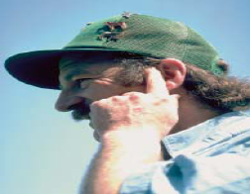
One finger
method with
the index
Direct
VAS pulse
control
SI19

Slide 16
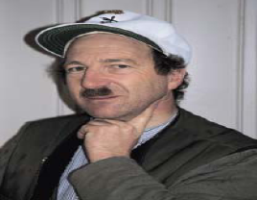
One finger
method with
the Index
Direct
VAS pulse
control
ST09

Slide 17
VAS Palpation: Two / Three Finger Method
Wrist Intersection
Punctum
Maximum
Arteria Radialis
Thumb
distally
Processus
styloideus
Ellbow

Slide 18
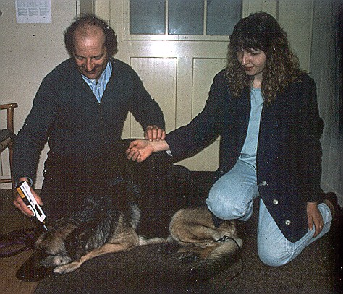
Indirect two/three finger VAS pulse control

Slide 19
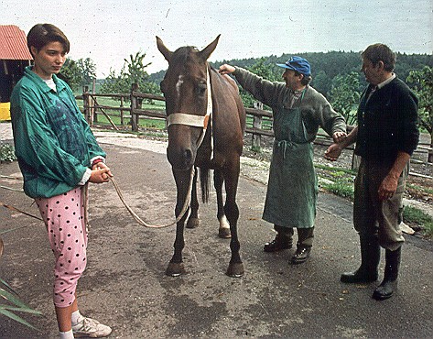
Indirect two/three finger VAS pulse control

Slide 20
Conclusion: VAS measurement by technical equipment is far less sensitive than the subjective detection of a trained therapist
VAS measurement by technical equipment was very much disturbed by breathing, especially on the Seismo- and Ballistogram and carotis pulse. It took an extremely effort to differ between physiological pulse- irregularities and VAS signals. Even a special Computerprogramm developed for the MIR experiments was involved
The skin with all its sensors is very much more sensitive to the VAS phenomenon

Slide 21
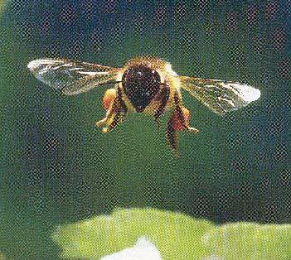
Good Luck wishes Andy

Slide 22
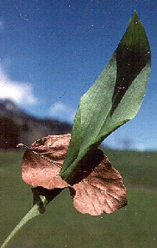
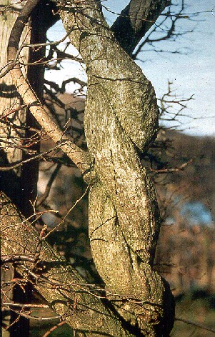
Acupuncture in Praxis
Presented
by
Andy Roesti, Switzerland

Slide 23
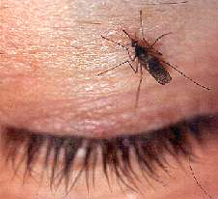

Slide 24
The Aura ≡
Electromagnetic Emanation
The Aura of any creature is the cybernetic light emanation of the coherent polarised photon-pool of the cell-nuclei
Fermions and Bosons are special oscillating conditions of the ethereal vacuum
The Aura consists of electrical-, magnetical-, electromagnetical-, acoustic- and Laser emanation

Slide 26
The quantitative aspect of the Aura is the distance from the patient to the Reflecting-Polaroid-Filter
In an oscillating patient the Aura ranges between 5 to 30 cm
In a healthy or balanced horse e.g. the Aura emanates for approximately 1 m
The qualitative aspect of the Aura is the deviation from the Orthopathy in <°
In a sick patient we always deal with a Heteropathy of 15° to 45° till 90° in cancer

Slide 27
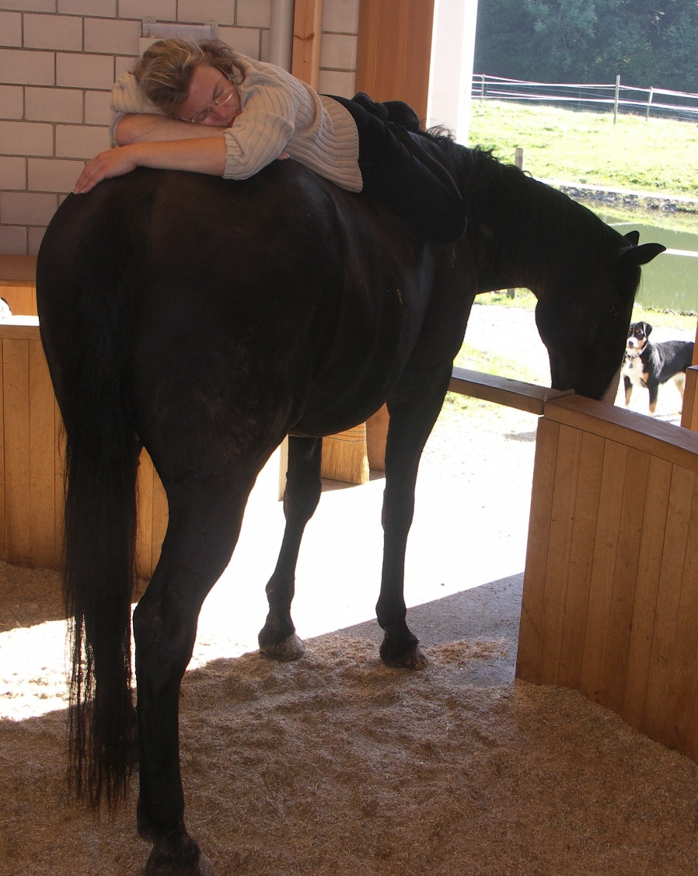
Aura- / Electro-Magnetic- Emanation
Quantitative Aspect
cm
Reflecting
Polaroid Filter

Slide 28
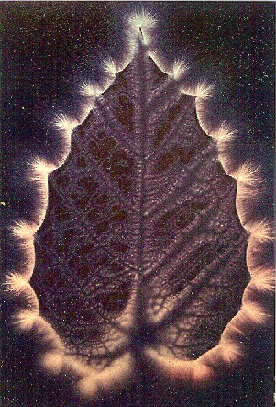
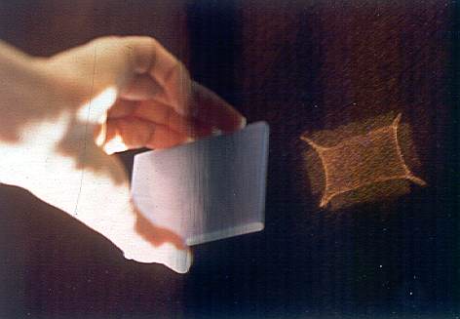
Quantitative Aspect of the Aura
Measuring by means of
the Reflecting-Polaroid-Filter
Aura-Kirlian-Photography

Slide 29
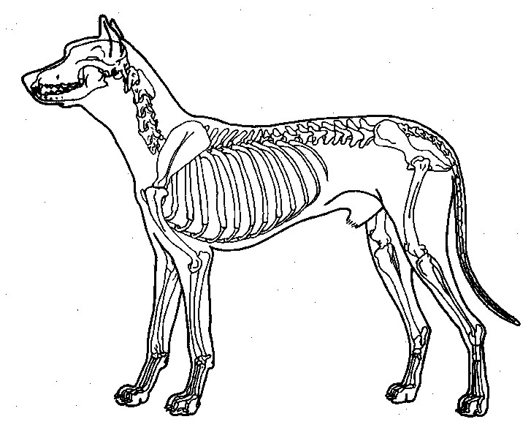
Aura Qualitative Aspect
Qualitative Aspect
Health
Pathology

Slide 30
Oscillation Definition
Normally we obtain always the same reflectory answer, whenever the same stimulus is provoking the bodies surface. On the other hand we obtain in an oscillating body always a different reflectory answer
Aetiologically it is supposed to be a disturbed irritation of the formatio reticularis in the brain stem, which is provoked through manifold exogenic, endogenic, iatrogenic, hidden and mute disturbancy focus
Often we find fatal combinations of different disturbancy fields

Slide 31
Anti - Oscillation
Yintang, EX-HN3
KI03, Source Pt of KI Meridian, mostly together with BL60. Single-Needle-Technique
Californian Flower Essences: Black Berry, Star Thistle
Self Heal: SI07-1
Homœopathic / Isopathic Treatment
Fr 9592 Hz

Slide 32
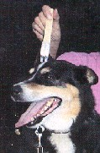
Checking Yintang for Oscillation

Slide 33
Single Needle Technique acc. to Andy
Sting the
needle undeneeth
the Achilles Tendon
KI03
BL60
Rear Chesunt
is medial

Slide 34
Inversion Definition
Inversion is a reflectory blockage of the Ggl. stellatum, or a mechanical blockage of the first rib
This causes a complete exchange of the reflectorial behaviour of the sympathetic and parasympathetic areas of the body
The swimming trunk area and the area above the clavicle becomes sympathetic and the rest of the body, below the clavicle, becomes parasympathetic

Slide 35
Inversion
Local sweeting in front of the
shoulder blade after a race
indicates pain and
Inversion

Slide 36
Anti - Inversion
3E 15, LI 16: Ggl. Stellatum, local Pts Mesotherapy: e.g. 5cc SeE + 5cc Lidocain 2% => 10cc SeE/Lidocaine at 1%, or proper, classical Neuraltherapy: 5cc Xyloneural® 1%
PC 6: Front chestnut, Cardinal Pt, Luo Pt => TH 4: (endocrine pancreas/insuline): opens the extrameridian Yin Wei Mai. Dry needeling or Mesotherapy, (Res. Californian Flower Essence: Quacking Grass)
Homœopathic / Isopathic Treatment

Slide 37
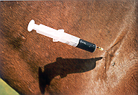
Inversion - Mesotherapy

Slide 38
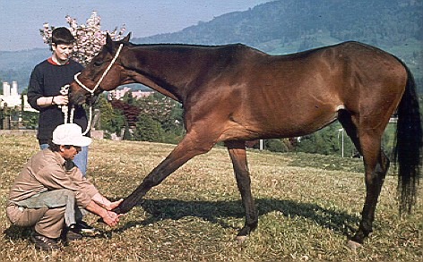
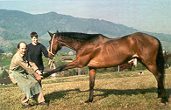
Inversion - Chiropractically

Slide 39
