Slide 2
Diagnostical Points for Herpes etc.
Rhino-Pneumonitis-Neurotrophic-Herpes Syndrome: Pt BL52-02: midway of a suggested line from Baihui→Tuber coxae
Influenza: Pt LU01 (Res. Bachflower Mimulus), KI27 (aside the cartilago praesterni)
Babesiosis: Pt LV14 (Res. Bachflower Vine or Calif. Flower Ess.: Californian Puppy), SP21 (Res. Lexotanile, Bach flower Aspen)
Tetanus: Pt GB34 (Master Pt of Muscles, Influential Pt of Tendons)
Equine Protozoal Myelitis Syndrome (EPM): Pt GB32-1, (70% more right rear)(Cain)

Slide 3
Diagnostical Viral Cheque Points
BL52-02
LU01
KI27
GB32-1
GB34
LV14
SP21

Slide 4
The Fifth Limb
Without deblocking all vertebras of the neck, you will always have troubles with your diagnostical and therapeutical procedure
Therefore control the Mirror Points of the neck
Deblock them Mesotherapeutically or Chiropractically

Slide 5
Diagnostical Points at the 5th Limb (Head & Neck) and at the Hind Limb (Cain)
AHSHI Pt. For conditions
Between fetlockand hoof
Osteochondritis
Dissecans Pt.: BL20
Local Tendon
Suspesory Pt.
TH15-6
Local
Foot Pt.
SI17
Local
Shin Pts.
TH15-4
TH15-2
AHSHI Pt. For conditions
Between hock and fetlock
3 Coxo-Femoral
Points: GB29,
GB29-1, GB30
TH15
Local
Fetlock Pt.
SI16-1
3 Stifle Points
BL36,37,38
Local
Carpal Pt.
SI16
2 Hock Points
BL39,BL40
Local ShoulderPoints:
SI10, TH14, LI15

Slide 6
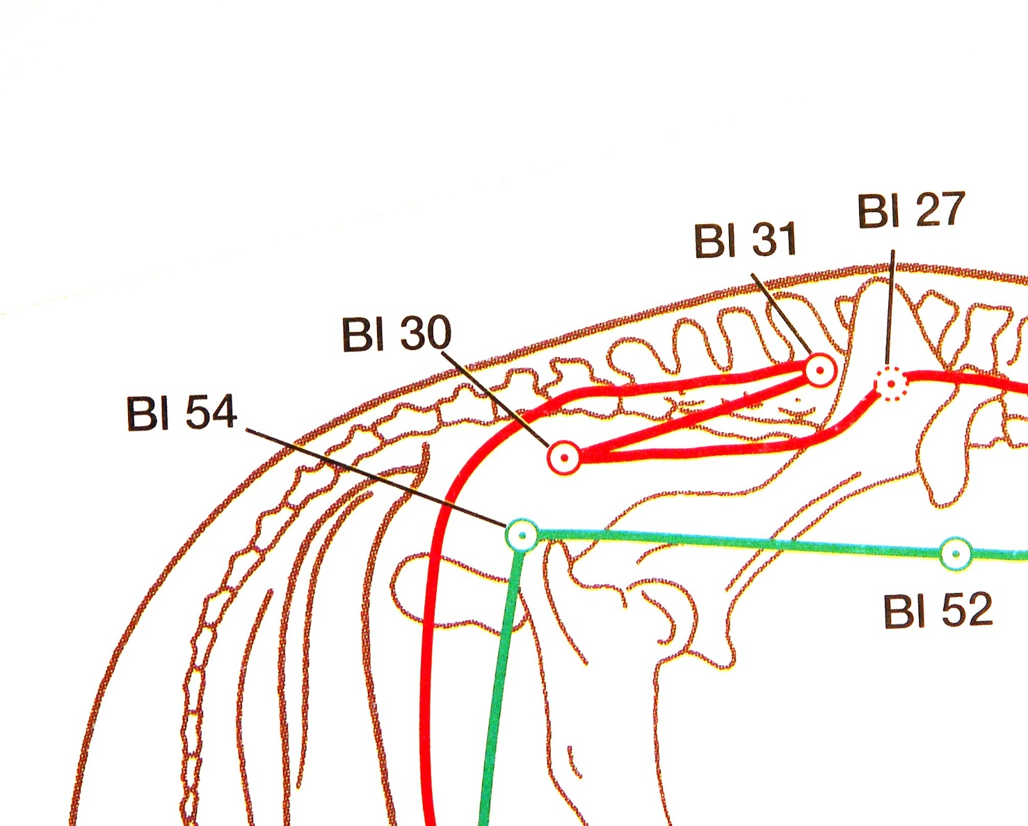
Mirror Pts of the Neck May be compared with the Huatuojiaj Pts
Vert: C8-T1
AO-Joint

Slide 7
Carrot Therapy

Slide 8
Shu – Mo - Technique
BL 11 Bone GB 39
BL 13 LU LU 1
BL 15 HT CV 14
BL 18 LIV LIV 14
BL 19 GB GB 24
BL 20 SP LIV 13
BL 21 ST CV 12
BL 22 TH CV 5,7,12,17
BL 23 KI GB 25
BL 25 LI ST 25
BL 27 SI CV 4
BL 28 BL CV 3

Slide 9
Extended Shu - Mo Technique
In animals especially with muscular problems, you deal with the complete Shu-Mo technique. We call it Forceps-Needeling
That means that you involve additionally to the traditional Shu-Mo technique the outside BL Meridian, which represents the muscular aspect of the body (Rule: inside BL-Pt + 29=outside BL point)

Slide 10
E.g. In a thoroughbread horse after a
three days eventing competition
Spleen Defiency: BL20 is very tender
+ BL20 Ass. Pt. left side (Spleen location)
– BL20 Ass. Pt. right side (opposite side of BL Meridian (Res. Suprarenin®)
+ LV13 A. Pt. right side (Res. Serotonin®)
– LV13 A. Pt. left side
+ BL49 right side
– BL49 left side
+ means Tonification
– means Sedation

Slide 11
Ting - Toni - Rule
Qi Deficiency in that meridian
Problems with the assigned or allocated organelles. e.g. LV: tendons, ligaments, eye, hoof, birth, anger, rage, fury
Tonify the Tonification Pt of that meridian, moxa, mesotherapy
Add the corresponding Ting Pt at the coronary band of the hoof
Add additionally the corresponding Reunion Pt
(Meeting Pt): GB13, GB22, SI19, CV03

Slide 12
Ting – Toni - Points
LU09 LU11 Very often used, COPD, asthma
LI11 LI0 1 Shoulder problems, immune def.
ST41 ST45 Often used, ammonia pollution
SP02 SP01 Pd & Formaldehyde pollution
HT09 HT09 Magnesium Pt
SI03 SI01 Colics
BL67 BL67 Very seldom used (cystitis)
KI07 KI01 Joint problems, arthrosis
PC09 PC09 Crataegus Pt
TH03 TH01 Cortisol Pt, arthrosis
GB43 GB44 Hip problems, arthrosis
LV08 LV01 Utmost important pair !!!, hoofs, tendons, ligaments

Slide 13
Cheque other options
Disturbancy focus, scars, abcesses, sinusitis, itch, worms, fodder, stable, owner
Meeting Pts: Three YIN, Three Yang PC05 / SP06; TH08 / GB39
ASHI Pt, very painful local Pt (Res Dolantin®)
Trigger Pt: Mesotherapy
Cardinal Pts: Mobilisation of ancestral Qi
Micro-Cosmic-Orbit: SP04, SI03, LU07

Slide 14
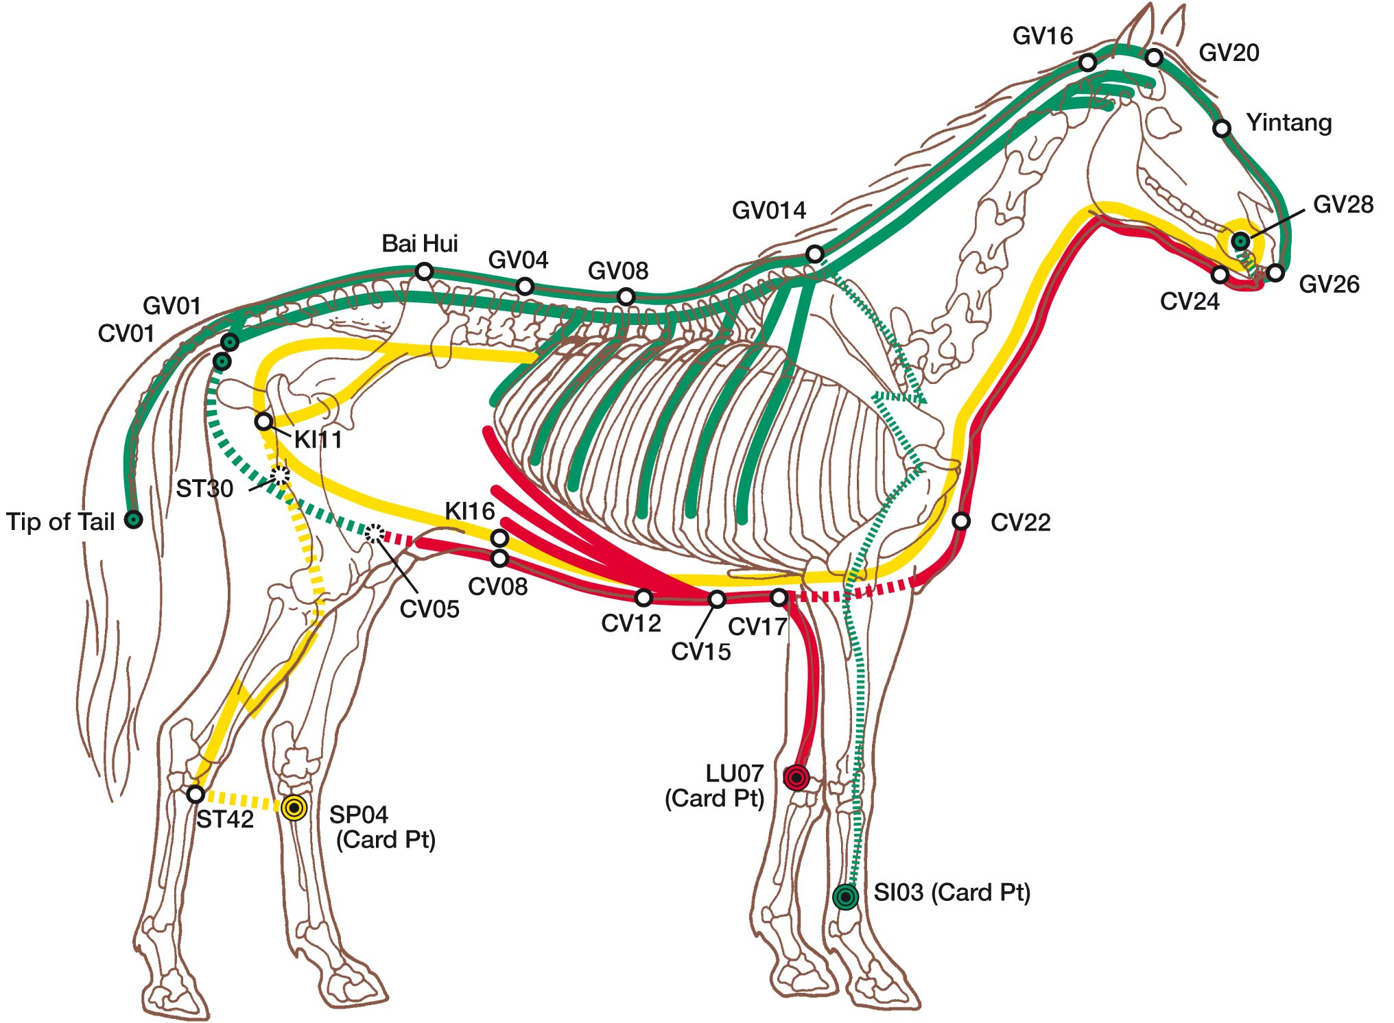
Micro – Cosmic - Orbit
Chong Mai
Penetrating Vessel SP04
Du Mai
Governing Vessel SI03
Ren Mai
Conception Vessel LU07

Slide 15
The Middle of the body:
Navel, EFA`s
Axis GV04←→CV08, Moxa on GV04
Dai Mai (Girdle Vessel): GB41
The Global YIN: SP21
Physiotherapy
Phytotherapy
Oligotherapy, etc.

Slide 16
Girdle Vessel – Dai Mai – GB41

Slide 18
Spleen Main Channel - Big LUO SP21
Connects all 6 YIN
meridians
SP21

Slide 19
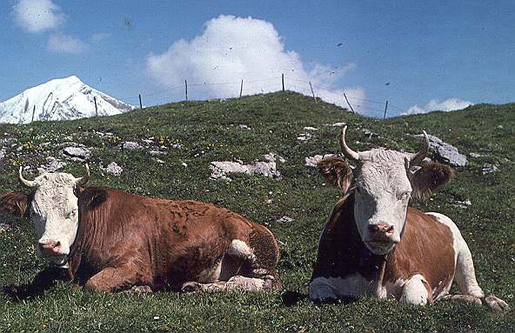
Fill up with Cosmic Qi

Slide 20
Success in Harmony

